Slide 1

#LifeKoKaroLift
Data Science Program

Slide 2


Course : Data Science
Lecture On : ML Models
Instructor : Sumit Shukla

Slide 3
Topics:
1
How to impute missing values
2
Data Imbalance
3
Coding practice on Google Colab

Slide 4
Missing Value Imputation

Slide 5
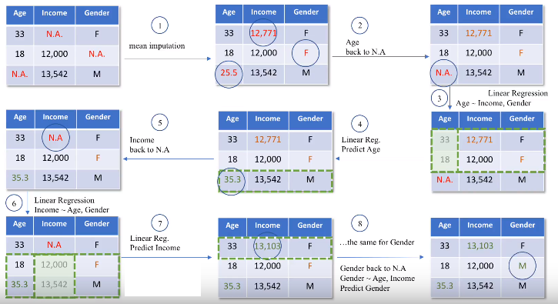
Missing Value Imputation
Iterative Imputer:
This technique imputes
the missing value multiple
times and measures
the goodness of imputed
values.

Slide 6
Data Imbalance
What is Data Imbalance:
Classification task: Data with more number of one class than other. Suppose there are 100 rows in data with 80 rows labelled as class 1 and 20 as class 2. Now this data is imbalanced.
How to handle it?
Oversampling
Let the algorithm handle it: Penalize algo(class_weight = ‘balanced’)
Use Tree based algorithms: Random forest.

Slide 7

#LifeKoKaroLift
Let’s Code

Slide 8
Let’s Code
Go to following link and download the data: https://www.kaggle.com/c/titanic/data
https://query.data.world/s/gb5wjsz5c76sgfyeas22h4loq7syqt
Load the train.csv data and answer the below questions:
Question-1: What are the number of non-nulls for “Age” variable?
891
714
126
Question-2: What is percentage of missing values for the variable “Embarked”?
0.22%
22%
0%

Slide 9
Let’s Code
Question-3: What is the fare value at 75th percentile?
$30
$32
$31
Question-4: Out of the total passengers, what is the percentage of females those survived the incident?
28%
12%
26%

Slide 10
Let’s Code
Now bucket the age variable into 4 groups defined as:
"Age" <= 16: 0
> 16 & <= 32 :1
> 32 & <= 48 :2
> 48 & <= 64 :3
"Age" > 64 :4
Question-5: Which age group survived the most?
1
2
3

Slide 11
Let’s Code
Question-6: Check the Embarked variable, which of the following category has the highest count?
S
C
Q
Question-7: Check the outliers in the “Age” variable, Is there any outliers?
Yes
No
Question-8: What is the Age value at 99th percentile?
54
65
80

Slide 12
Let’s Code
Question-9: Remove the -ve values from the age variable and check what is the minimum value in the age variable?
0.5
0.4
1
Question-10: Check Fare variable, is there any outliers in the fare variable?
Yes
No
Drop all the rows where fare is greater than $300
Question-11: Now, check the fare value at 90th percentile?
30
77
100

Slide 13
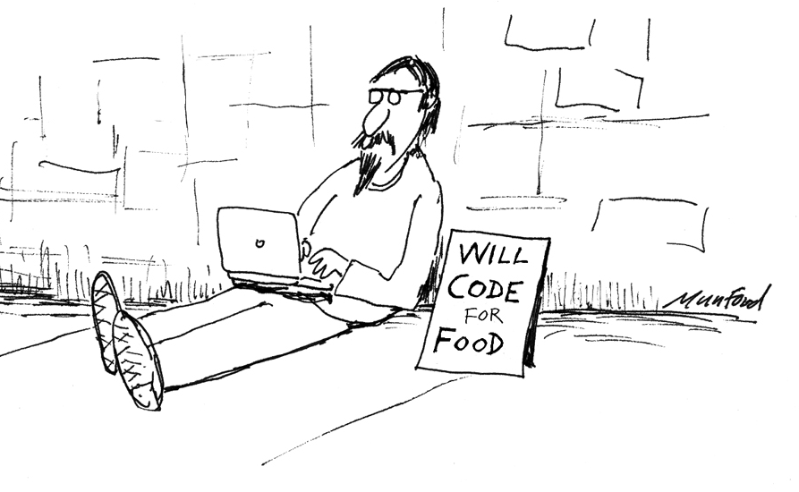
#LifeKoKaroLift
Break Time

Slide 14
Let’s Code
Question-12: What is the survival rate for the given data(Complete data)?
40%
50%
60%
Proceed with these steps:
Divide the data into X and Y
Create the dummies for categorical features
Scale the X data
Question-13: Check the correlation between X variables, which two variables are highly negatively correlated?
Age & Pclass3
Fare & Pclass3
Pclass2 & Pclass3

Slide 15
Let’s Code
Question-14: What is the accuracy of the Logistic Regression model on test data using SKLearn with default parameters?
70%
80%
90%
Question-15: What is the Sensitivity of the model on test data using L1 regularisation with default parameters?
70%
80%
90%

Slide 16
Let’s Code
Question-16: What is the Sensitivity of the model on test data using L1 regularisation and C=0.1?
70%
80%
90%
Run grid search for following values of C: 0.0001, 0.001, 0.005, 0.1,0.2 ,0.3 ,0.4, 0.5, 1, 2, penalty as ['l1', 'l2'] and class_weight as [{0:0.4, 1: 0.6}, 'balanced']
Question-17: What is the value of the best C obtained after running Grid search CV?
0.1
0.3
0.4

Slide 17
Let’s Code
Question-18: Run the model with the best parameters obtained, What is the sensitivity of the model on test data?
75%
74%
78%
Question-19: Which variable seems to be most important according to the model?
Age
Sex
Fare

Slide 18
Let’s Code
Question-20: Run Random Forest with default parameters, What is the sensitivity of the model on test data?
65%
68%
78%
Perform Grid Search using the following parameters: { "criterion" : ["gini", "entropy"], "min_samples_leaf" : [1, 5, 10], "min_samples_split" : [2, 4, 10, 12, 16], "n_estimators": [50, 100, 400, 700, 1000], 'class_weight': [{0:0.4, 1: 0.6}, 'balanced']}
Question-21: Run the final RF model with the best parameters given as Best hyperparameters: {'class_weight': 'balanced', 'criterion': 'gini', 'min_samples_leaf': 1, 'min_samples_split': 16, 'n_estimators': 700}. What is the sensitivity of the model on test data?
75%
77%
78%

Slide 19
Let’s Code
Question-22: Check the feature importance, Which variable is the most important feature?
Age
Sex
Fare
Take Away Question: Use the test data from Kaggle and predict on it using the model. What is the survival percentage?
30%
40%
50%

Slide 20
Take Home Challenge
Till now we tried to solve this problem using L1 and L2 regularisation and we saw we were able to achieve 74% test sensitivity. Now try using RFE on this data to choose the best features and check if the sensitivity of the model can be improved or not?
Try to handle the cabin variable without dropping it and check if the model sensitivity can be improved. Hint: C123 can be converted C which represent the deck level: Refer to the image: https://upload.wikimedia.org/wikipedia/commons/thumb/8/84/Titanic_cutaway_diagram.png/402px-Titanic_cutaway_diagram.png

Slide 21
#LifeKoKaroLift
Thank You!

